Slide 1

Microprogram
Examples

Slide 2
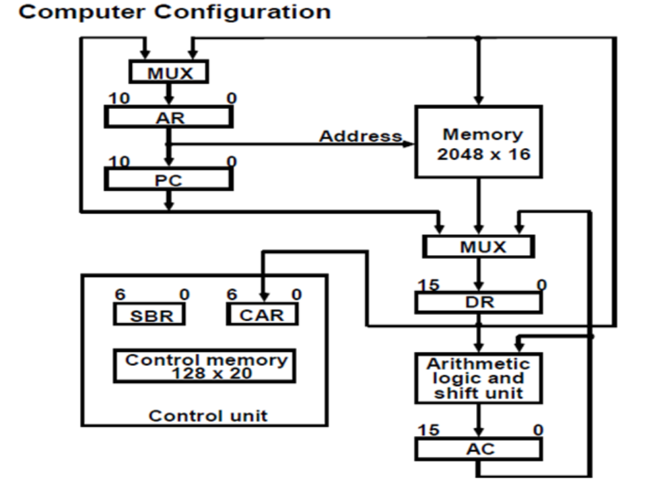
Microprogram Example

Slide 3
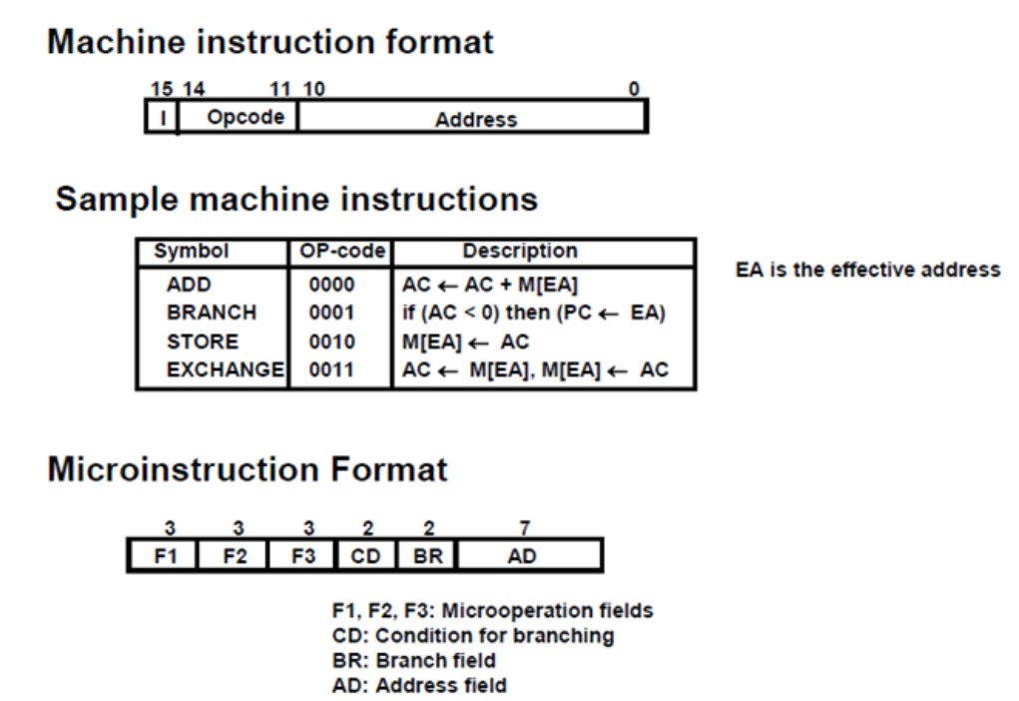
Computer Instructions

Slide 4
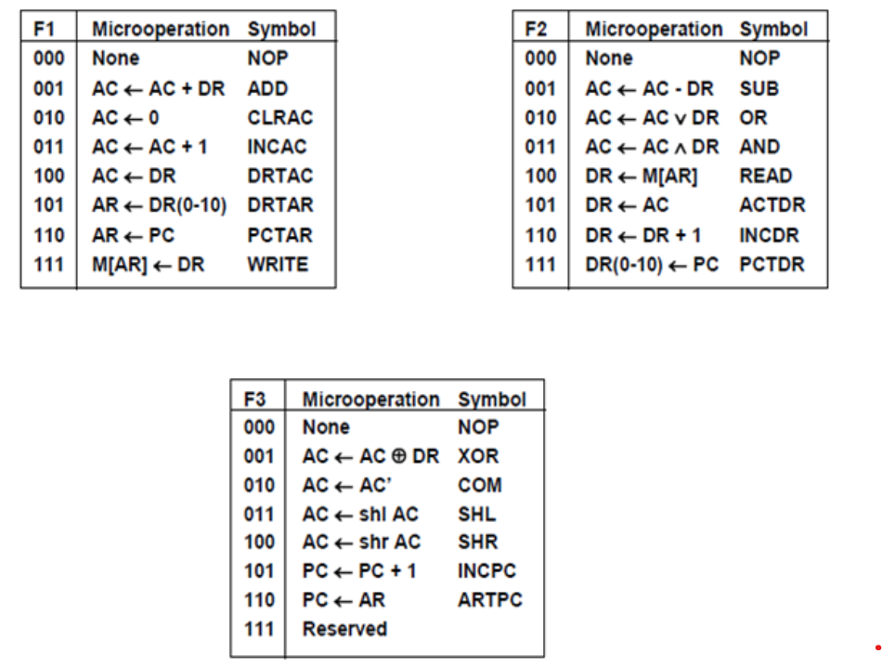
Symbols and binary code for microinstructions field

Slide 5
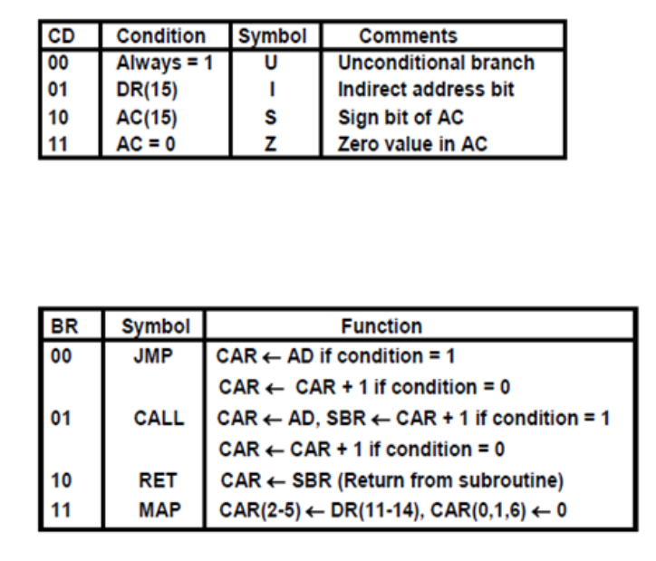
Symbols and binary code for microinstructions field

Slide 6
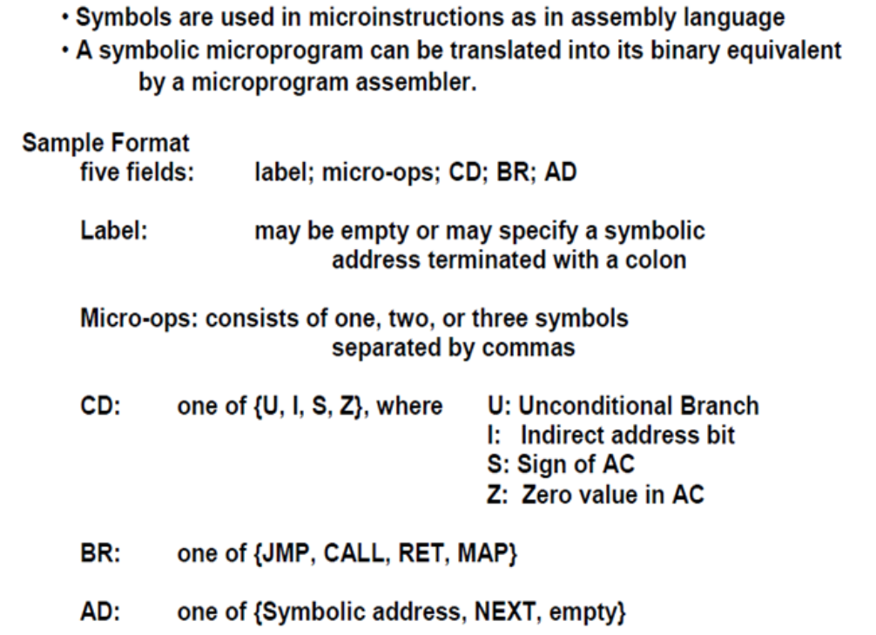
Symbolic Microinstructions

Slide 7
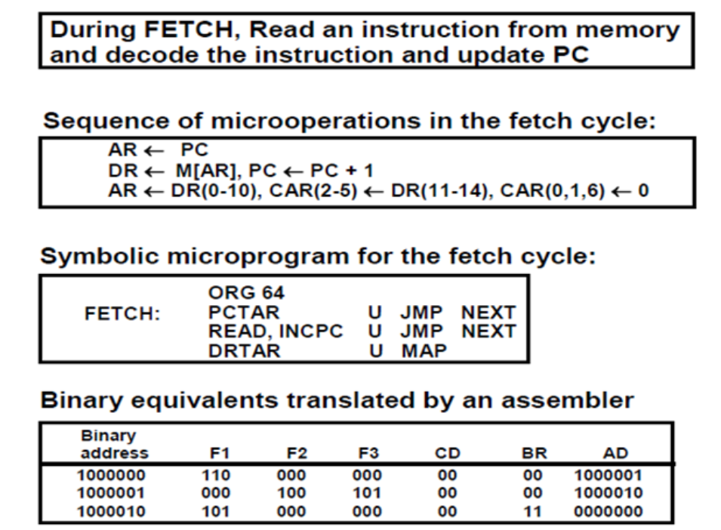
Fetch Routine

Slide 8
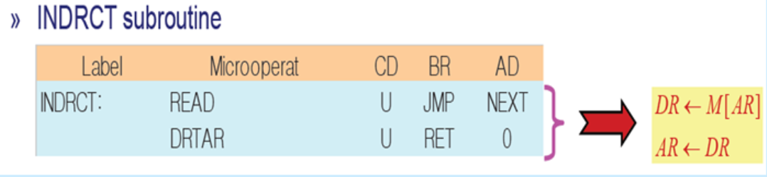
Symbolic Microprogram: Indirect Routine

Slide 9
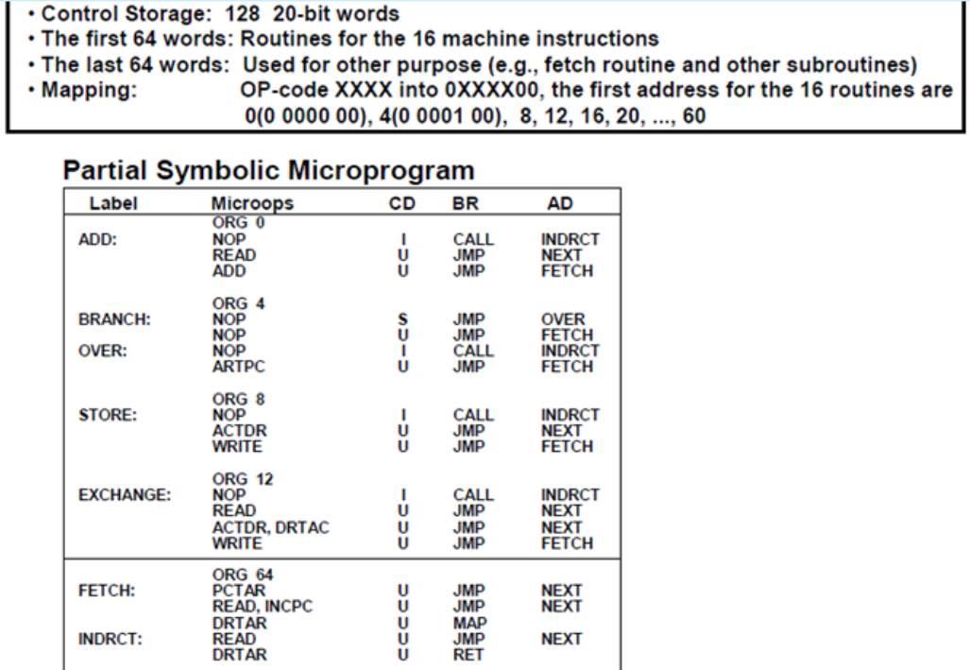
Symbolic Microprogram

Slide 10
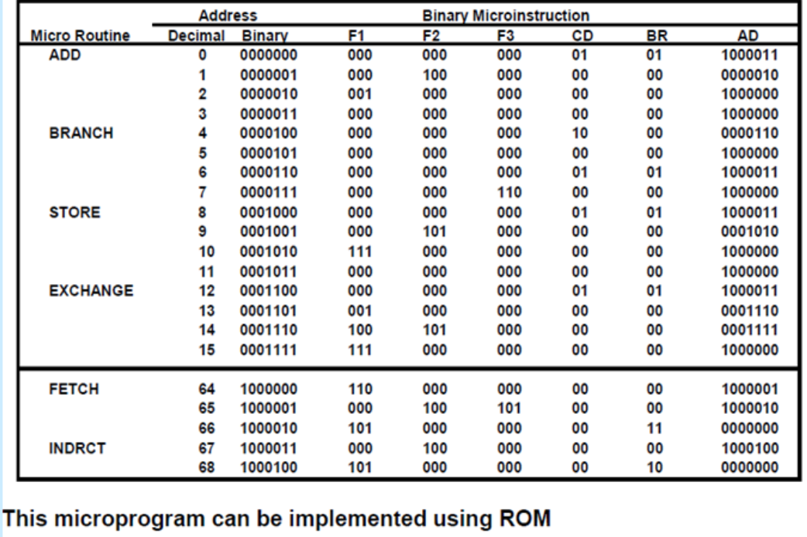
Symbolic Microprogram

